Slide 1
Binary Addition & Subtraction

Slide 2
Binary Addition, Subtraction (single digit)
The rules for binary addition are:
The rules for binary subtraction are:
0 + 0 = 0, carry = 0
0 - 0 = 0, borrow = 0
1 + 0 = 1, carry = 0
1 - 0 = 1, borrow = 0
0 + 1 = 1, carry = 0
0 - 1 = 1, borrow = 1
1 + 1 = 0, carry = 1
1 - 1 = 0, borrow = 0
Multiple digits:
Borrows, Carries from digits to left of current of digit.
Binary subtraction, addition works just the same as decimal addition, subtraction.

Slide 3
Adding Binary Numbers
0
1
1
1
0
0
0
28
+ 43
71
⎯→ 00011100
⎯→ + 00101011
0
1
0
0
0
1
1
1
‹#›

Slide 4
1’S Complement
01010011
↓ ↓ ↓ ↓ ↓ ↓ ↓ ↓
10101100
Invert All Bits
‹#›

Slide 5
2’S Complement
01010011
↓ ↓ ↓ ↓ ↓ ↓ ↓ ↓
10101100
+1
10101101
Invert All Bits
Add One
‹#›

Slide 6
Add/Sub : 4 Combinations
9
+ 5
14
(-9)
+ 5
- 4
Positive / Positive
Positive Answer
Negative / Positive
Negative Answer
9
+ (-5)
4
(-9)
+ (-5)
- 14
Positive / Negative
Positive Answer
Negative / Negative
Negative Answer
‹#›

Slide 7
Positive / Positive Combination
9
+ 5
14
00001001 + 00000101
⎯→
⎯→
Positive / Positive
Positive Answer
←⎯
00001110
Both Positive Numbers
Use Straight Binary Addition
‹#›

Slide 8
Positive / Negative Combination
9
+ (-5)
4
00001001
⎯→
Positive / Negative
Positive Answer
+ 11111011
←⎯
1]00000100
1-Positive / 1-Negative
Take 2’s Complement
Of Negative Number (-5)
8th Bit = 0 : Answer is Positive
Disregard 9th Bit
00000101
↓↓↓↓↓↓↓↓
11111010
+1
11111011
2’s
Complement
Process
‹#›

Slide 9
Negative / Positive Combination
(-9)
+ 5
- 4
11110111
Positive / Negative
Negative Answer
⎯→
+ 00000101
11111100
1-Positive / 1-Negative
Take 2’s Complement
Of Negative Number (-9)
8th Bit = 1 : Answer is Negative
Take 2’s Complement to Check Answer
11111100
↓↓↓↓↓↓↓↓
00000011
+1
00000100
00001001
↓↓↓↓↓↓↓↓
11110110
+1
11110111
2’s
Complement
Process
2’s
Complement
Process
‹#›

Slide 10
Negative / Negative Combination
(-9)
+ (-5)
- 14
⎯→
11110111
2’s Complement
Numbers, See
Conversion Process
In Previous Slides
Negative / Negative
Negative Answer
⎯→
+ 11111011
1]11110010
2-Negative
Take 2’s Complement Of
Both Negative Numbers
8th Bit = 1 : Answer is Negative
Disregard 9th Bit
Take 2’s Complement to Check Answer
11110010
↓↓↓↓↓↓↓↓
00001101
+1
00001110
2’s
Complement
Process
‹#›

Slide 11
BCD Codes
BCD Code (Binary-Coded Decimal): A code used to represent each decimal digit of a number by a 4-Bit Binary Value.
Valid Digits for 0 to 9 are 0000 to 1001.
The binary codes 1010 to 1111 are invalid
Called an 8421 Code due to the decimal weight of each bit position.
‹#›

Slide 12
BCD Examples
Each digit is a 4-Bit Binary group:
(84)₁₀ = 1000 0100
(4987)₁₀ = 0100 1001 1000 0111_{BCD}
‹#›

Slide 13
Excess-3 Code
A BCD Code formed by adding 3 (0011) to its true 4-bit binary value.
Excess-3 is a self-complementing code:
A negative code equivalent can be found by inverting the binary bits of the positive code
Inverting the bits of the Excess-3 digit yields 9’s Complement of the decimal equivalent.
‹#›

Slide 14
Excess-3 BCD Code
The Excess-3 (XS-3) BCD code does not use the principle of positional weights into consideration while converting the decimal numbers to 4-bit BCD system. Therefore, we can say that this code is a non-weighted BCD code.
The function of XS-3 code is to transform the decimal numbers into their corresponding 4-bit BCD code.
In this code, the decimal number is transformed to the 4-bit BCD code by first adding 3 to all the digits of the number and then converting the excess digits, so obtained, into their corresponding 8421 BCD code. Therefore, we can say that the XS-3 code is strongly related with 8421 BCD code in its functioning.

Slide 15
Excess-3 BCD Code
Decimal digits | Excess-3 BCD code
0 | 0011
1 | 0100
2 | 0101
3 | 0110
4 | 0111
5 | 1000
6 | 1001
7 | 1010
8 | 1011
9 | 1100

Slide 16
Excess-3 BCD Code
Convert the decimal number 85 to XS-3 BCD code.
Add 3 to each digit of the given decimal number as:
8+3=11
5+3=8
The corresponding 4-bit 8421 BCD representation of the decimal digit 11 is 1011.
The corresponding 4-bit 8421 BCD representation of the decimal digit 8 is 1000.
Therefore, the XS-3 BCD representation of the decimal number 85 is 1011 1000.

Slide 17

Gray Code
A binary code that progresses so that only one bit changes between two successive codes.
‹#›

Slide 18
Gray Code and Binary
Binary: b₃b₂b₁b₀
Gray: g₃g₂g₁g₀
Gray code bits can be defined as follows:
g₃ = b₃
g₂ = b₃ ⊕ b₂
g₁ = b₂ ⊕ b₁
g₀ = b₁ ⊕ b₀
‹#›

Slide 19
The Gray Code
Binary-to-Gray code conversion
The MSB in the Gray code is the same as corresponding MSB in the binary number.
Going from left to right, add each adjacent pair of binary code bits to get the next Gray code bit. Discard carries.
ex: convert 10110₂ to Gray code
1 + 0 + 1 + 1 + 0 binary
1 1 1 0 1 Gray
Notes:
‹#›

Slide 20
The Gray Code
Gray-to-Binary Conversion
The MSB in the binary code is the same as the corresponding bit in the Gray code.
Add each binary code bit generated to the Gray code bit in the next adjacent position. Discard carries.
ex: convert the Gray code word 11011 to binary
1 1 0 1 1 Gray
+ + + +
1 0 0 1 0 Binary
Notes:
‹#›

Slide 21
The Gray Code
Decimal | Binary | Gray Code
0 | 0000 | 0000
1 | 0001 | 0001
2 | 0010 | 0011
3 | 0011 | 0010
4 | 0100 | 0110
5 | 0101 | 0111
6 | 0110 | 0101
7 | 0111 | 0100
Decimal | Binary | Gray Code
8 | 1000 | 1100
9 | 1001 | 1101
10 | 1010 | 1111
11 | 1011 | 1110
12 | 1100 | 1010
13 | 1101 | 1011
14 | 1110 | 1001
15 | 1111 | 1000
Notes:
‹#›

Slide 22
ASCII Code
American Standard Code for Information Interchange.
A seven-bit alphanumeric code used to represent text letters, numerals, punctuation, and special controls.
An expanded 8-bit form is becoming more widespread.
‹#›

Slide 23
Codes

Slide 24
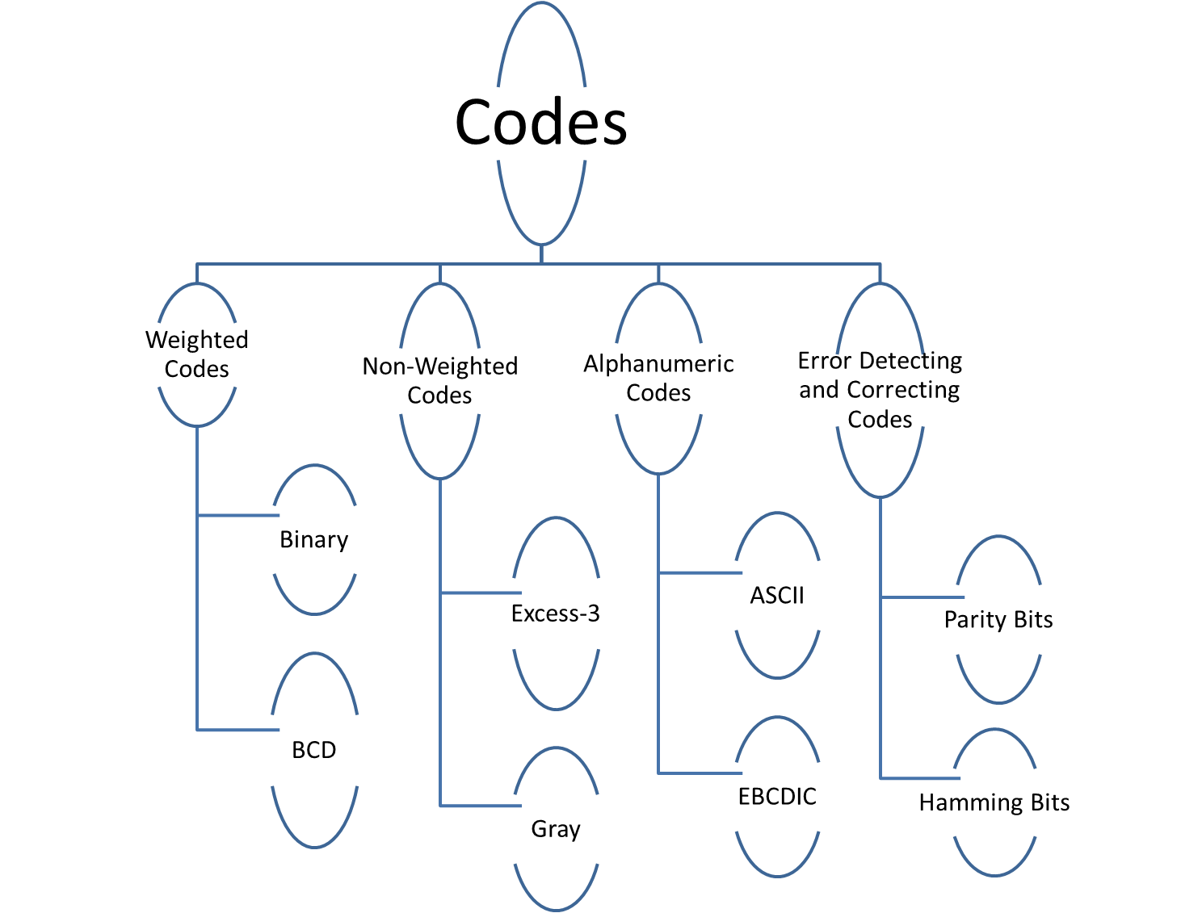

Slide 25
Binary Coded Decimal
Decimal Digit | 0 | 1 | 2 | 3 | 4 | 5 | 6 | 7 | 8 | 9
BCD | 0000 | 0001 | 0010 | 0011 | 0100 | 0101 | 0110 | 0111 | 1000 | 1001
Note: 1010, 1011, 1100, 1101, 1110, and 1111 are INVALID CODE!
Each Decimal Digit 0-9 are represented by their Natural Binary Equivalent using 4 bits
Of a Decimal Number, each of its bits are represented by its 4 bit Natural Binary Equivalent
Also known as 8421 Code
Notes:
‹#›

Slide 26
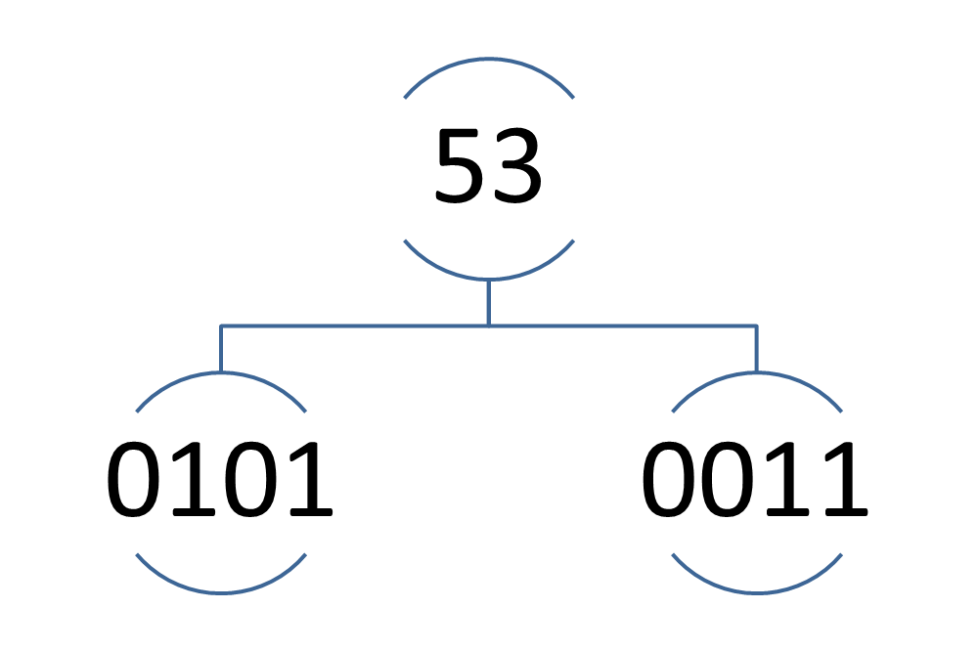
Binary Coded Decimal (BCD)
Examples:
Binary Coded Decimal (BCD)
‹#›

Slide 27
Binary Coded Decimal (BCD)
Examples:
(234)₁₀ = (0010 0011 0100)_{BCD}
(7093)₁₀ = (0111 0000 1001 0011)_{BCD}
(1000 0110)_{BCD} = (86)₁₀
(1001 0100 0111 0010)_{BCD} = (9472)₁₀
Notes: BCD is not equivalent to binary.
Example: (234)₁₀ = (11101010)₂
Binary Coded Decimal (BCD)
‹#›

Slide 28
Excess-3 Code
The Excess-3 code for each decimal digit is obtained by adding 3 to the BCD Code of the digit.
It is not a Weighted Code
Also called XS-3 or Ex-3 Code
Find the Ex-3 code of (11)₁₀
(11)₁₀ = (0001 0001)_{BCD}
+ 0011 0011
___________________________
(11)_{Ex-3} = 0100 0100
Binary Coded Decimal (BCD)
‹#›

Slide 29
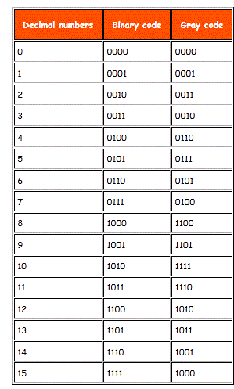
Gray code
Also called Unit Distance Code or Cyclic Code or Reflected Code or Mirror Reflecting Code.
In this code, a decimal number is represented in such a way that it exhibits only a single bit change from one code word to next in sequence
Notes:
‹#›

Slide 30
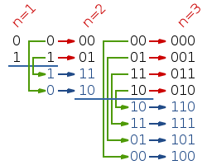
Construction of Gray Code by reflection
Here n =no of bits
Notes:
‹#›

Slide 31
Binary-to-Gray code conversion
The MSB in the Gray code is the same as corresponding MSB in the binary number.
Add the Msb in Binary to the bit immediately to its right in binary to get the next gray bit.Discard carries.
Repeat step 2 until all the bits in binary no have been added.
ex: convert 10110₂ to Gray code
1 + 0 + 1 + 1 + 0 binary
1 1 1 0 1 Gray
MSB
MSB
Notes:
‹#›

Slide 32
Gray-to-Binary Conversion
The MSB in the binary code is the same as the corresponding bit in the Gray code.
Add each binary code bit generated to the Gray code bit in the next adjacent position. Discard carries.
ex: convert the Gray code word 11011 to binary
1 1 0 1 1 Gray
+ + + +
1 0 0 1 0 Binary
Notes:
‹#›

Slide 33
Alphanumeric Code
DD systems are required to handle data that may be
Numerals
Letters(Capital and small)
Punctuation marks
Other symbols
For Eg- An university with data of thousands of students. The names of the students, subjects etc are to be represented in Binary form.
Thus a Binary Code for all such symbols is needed.
Notes:
‹#›

Slide 34
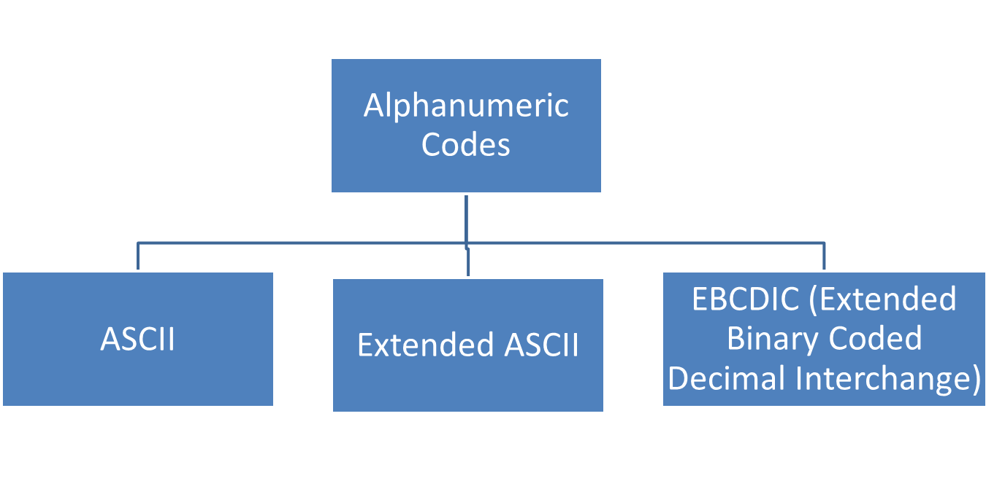
Alphanumeric Code
Codes that represent numbers and alphabetic characters.
Notes:
‹#›

Slide 35
ASCII Codes
American Standard Code for Information Interchange.
Universally accepted Alphanumeric Code
Used in most Computers and electronic equipments, when we press a key, The corresponding ASCII code is generated .
Notes:
‹#›

Slide 36
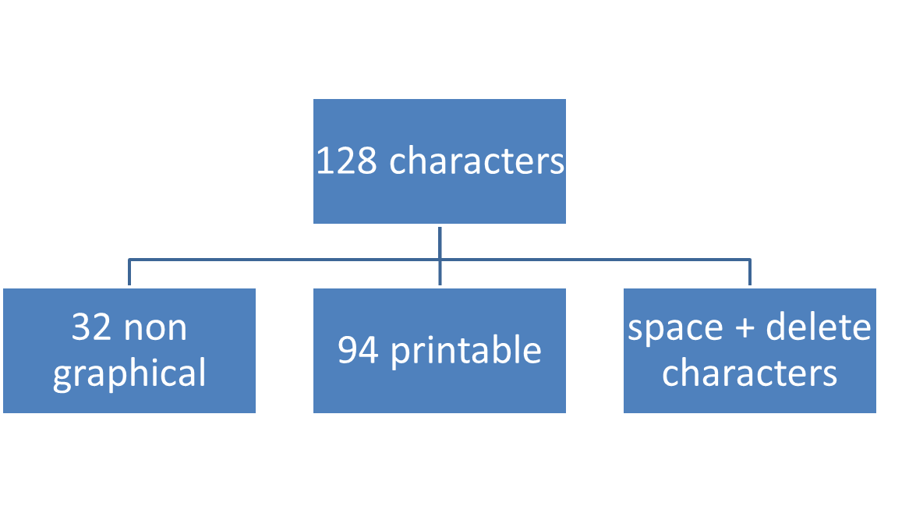
ASCII Codes
Has 128 characters
Uses 7 bits => 2⁷
In the ASCII character set, each binary value between 0 and 127 represents a specific character.
Notes:
‹#›

Slide 37
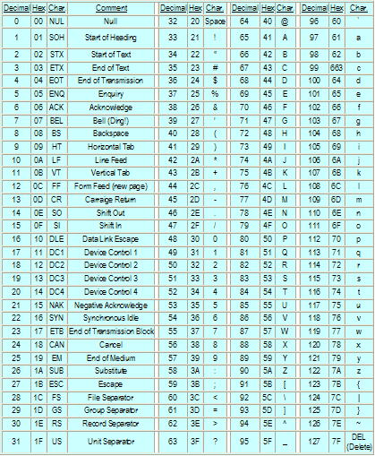
ASCII

Slide 38
Extended ASCII Codes
The Normal ASCII 128 characters were called Standard Characters
With 8 bits , 2⁸ =256 characters were possible.
The extra 128 characters were called Extended ASCII characters
Notes:
‹#›

Slide 39
Extended ASCII Codes
Uses 8 bits.
Has 256 characters.
The extended ASCII characters were:
Non-English alphabetic
Foreign currency symbol
Greek letters
Mathematical symbols
Drawing characters
Bar Graph characters
Shading characters
Notes:
‹#›

Slide 40
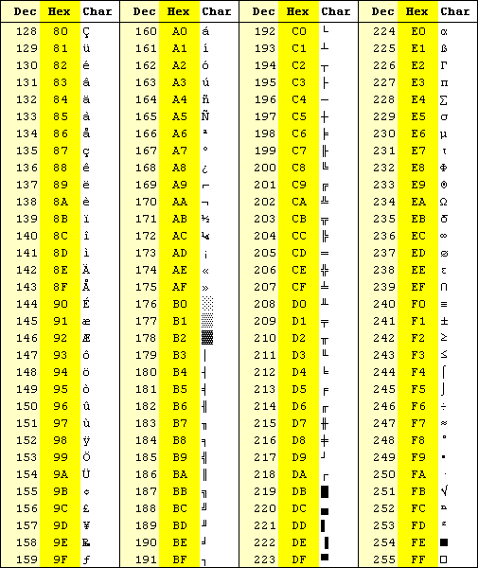
Extended ASCII
Another example:
You want to represent the Yen sign (¥)
From the table: 9D
9₁₆ = 9₁₀ = 1001₂
D₁₆ = 13₁₀ = 1101₂
The ¥ sign in binary is: 1001 1101
Detailed table

Slide 41
EBCDIC
EBCDIC
Expanded name Extended Binary Coded Decimal Interchange Code
Proprietary specification developed by IBM
Characteristics/description A set of national character sets for interchange of documents between IBM mainframes. Most EBCDIC character sets do not contain all of the characters defined in the ASCII code

Slide 42
EBCDIC
Usage Not much used outside of IBM and similar mainframe environments. When transmitting EBCDIC files between systems care needs to be taken to ensure that the systems are set up for the relevant national code set.

Slide 43
Error
Digital Signal are transmitted from one location(transmitter) to another (reciever), transmission errors may occur due to electrical noise in the transmission channel.
Due to transmission error , a signal transmitted as 0 may be received as 1 or vice-versa.
A digital data is transmitted in the form of a code. For eg- BCD, ASCII.
There is a probability of occurrence of error in a single bit position.
The probability of occurrence of error in 2 or more bit positions is substantially smaller.
Notes:
‹#›

Slide 44
Error detecting codes:
PARITY BITS
For a n bit Code, if an extra bit is attached to the n bit code to make the number of bits n+1
In such a way so as to make “the number of Ones in the resulting (n+1) bit code, even or odd, it will be error detecting code, rendering even or odd parity.
That extra bit is known as Parity bit.
Notes:
‹#›

Slide 45
PARITY BITS
Two common schemes (for single parity bits): -
even parity bit={0 if data contains an even number of 1's
else 1 }
odd parity bit ={0 parity bit if data contains an odd number of 1's
Else 1 }

Slide 46
Parity Bit
A single bit is appended to each data chunk
makes the number of 1 bits even/odd
Example: even parity
1000000(1)
1111101(0)
1001001(1)
Example: odd parity
1000000(0)
1111101(1)
1001001(0)

Slide 47
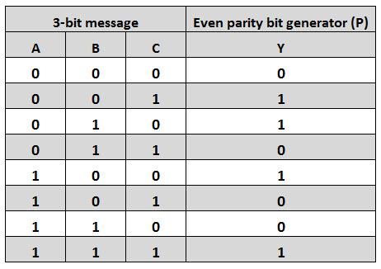
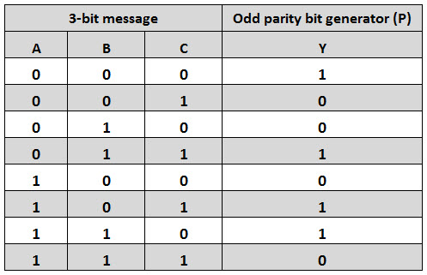
Even Parity Generator
Parity Bit Generator
Appends the Parity bit to the Data Chunk
Odd Parity Generator

Slide 48
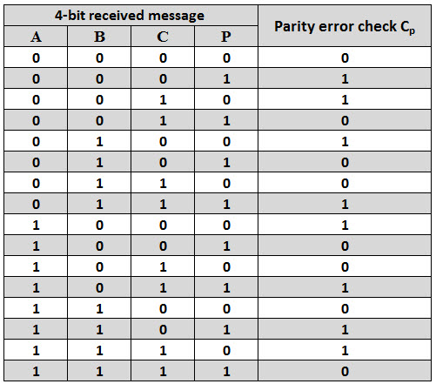
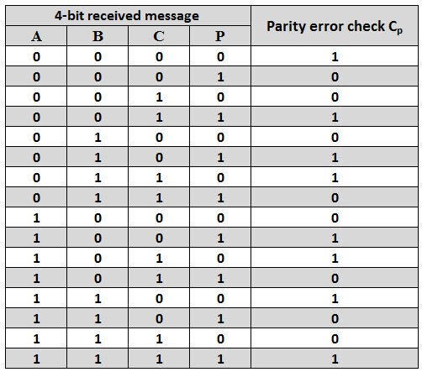
Even Parity Check
Parity Checker
At the Destination, the parity Checker again computes the Parity for (n+1) bits.
If parity=0 then no Error
Else Error has Occured
Odd Parity Checker

Slide 49
DRAWBACK OF PARITY BITS
Parity bit can only detect error. It cannot locate the bit which has been corrupted and cannot correct it.
Used for One bit error only.

Slide 50
HAMMING CODE

Slide 51
Minimum Number of Parity bits
No of bits in Data Unit (m) | No of parity Bits (r)
1 | 2
2 to 4 | 3
5 to 11 | 4
12 to 26 | 5
27 to 57 | 6
58 to 120 | 7
Deciding the Value of Parity bits
parity Bits | Bits to be Checked
P₁ | 1,3,5,7,9,11,13,15
P₂ | 2,3,6,7,10,11,14,15
P₄ | 4,5,6,7,12,13,14,15
P₈ | 8,9,10,11,12,13,14,15

Slide 52
A data Unit of 4 bits 1011 is to be transmitted . Construct the even parity Hamming Code for the data
No of data bits=m=4
No of Parity Bits=r=3
Total Unit length =7
Arrangement of the Data & Parity Unit is :
i.e.
(refer R.P.Jain pg no 65-67)
D | D | D | P₄ | D | P₂ | P₁
1 | 0 | 1 | P₄ | 1 | P₂ | P₁
Bit 7 | Bit 6 | Bit 5 | Bit 4 | Bit 3 | Bit 2 | Bit 1

